Slide 1
LFO Student Success Center
Graduation = Success!

Slide 2
What is the Student Success center?
It’s a place where kids:
Belong
Serve
Receive Support
Have Fun

Slide 3
Every LFO Student will be successful!
Graduation = school completion!
70% of inmates are dropouts
Dropouts represent nearly half of welfare
No college w/out high school diploma
Lower wages, fewer jobs, shorter lives, etc.
Strongest dropout predictor: Family dynamic
We can not leave one Warrior behind!

Slide 4
Barriers to success fall into these areas
Academic
Behavioral
Social
Toughest barriers for these students are not academic, but social-Family characteristics
Least control over social barriers
How do we remove them?

Slide 5
Make every student a 3rd base kid!
Academic Support
Social Support
Behavioral Support
Some kids start school on 3rd base, but many others do not.
Support these students beyond the classroom
Partnership with CIS to support at-risk students
Connect students/parents with support
What do these areas of support consist of?

Slide 6
Academic Support
Peer tutoring!
Morning study hall
FLEX Lunch
Involve parents!
Guidance counselors
Classroom teachers
IEP tutoring
CONNECTed

Slide 7
Behavioral Support
PBIS team
Mindset strategies
Innovative discipline
Teacher coaching
Attendance Support Team!
SRO mentoring
Relationship building

Slide 8
Social Support
Communities in Schools
Catoosa County Sherriff’s Office
Dept. of Juvenile Justice
Dept. of Family and Children’s Service
Georgia Hope
United Way
Catoosa County Magistrate Court
Georgia Vocational Rehabilitation Agency
Laundry facility
Food Pantry
Clothing closet

Slide 9
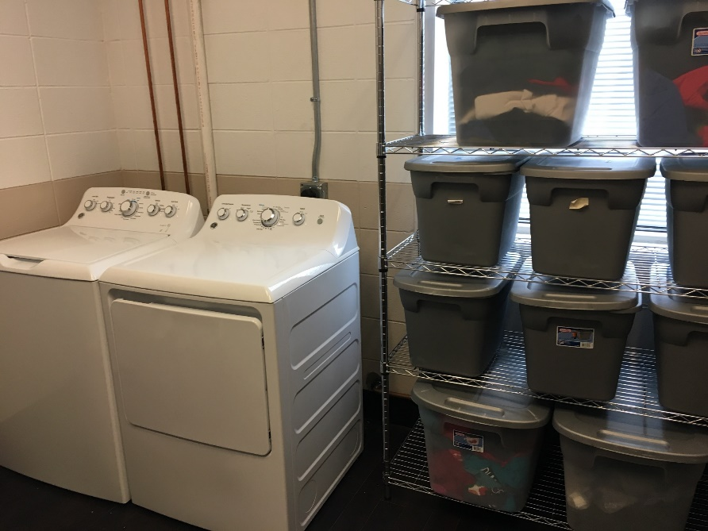
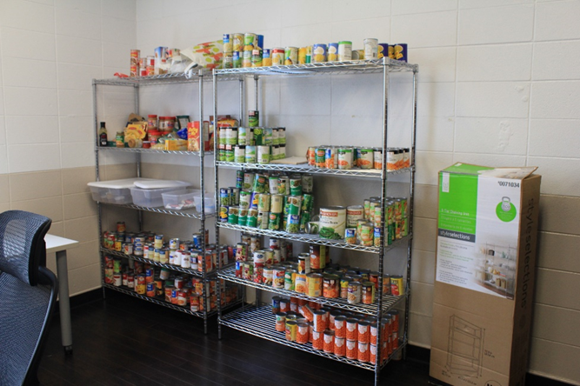
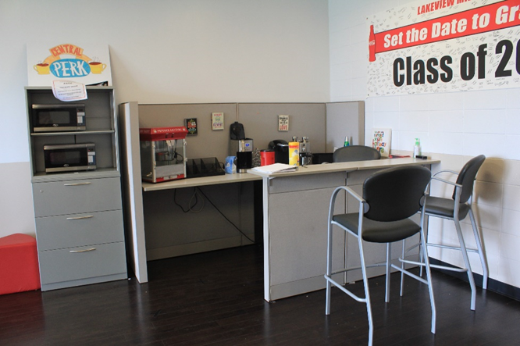
LFO Student Success Center: Making every kid a 3rd base kid!

Slide 10
“Vision is the art of seeing what is invisible to others”
-Jonathan Swift

